Slide 1
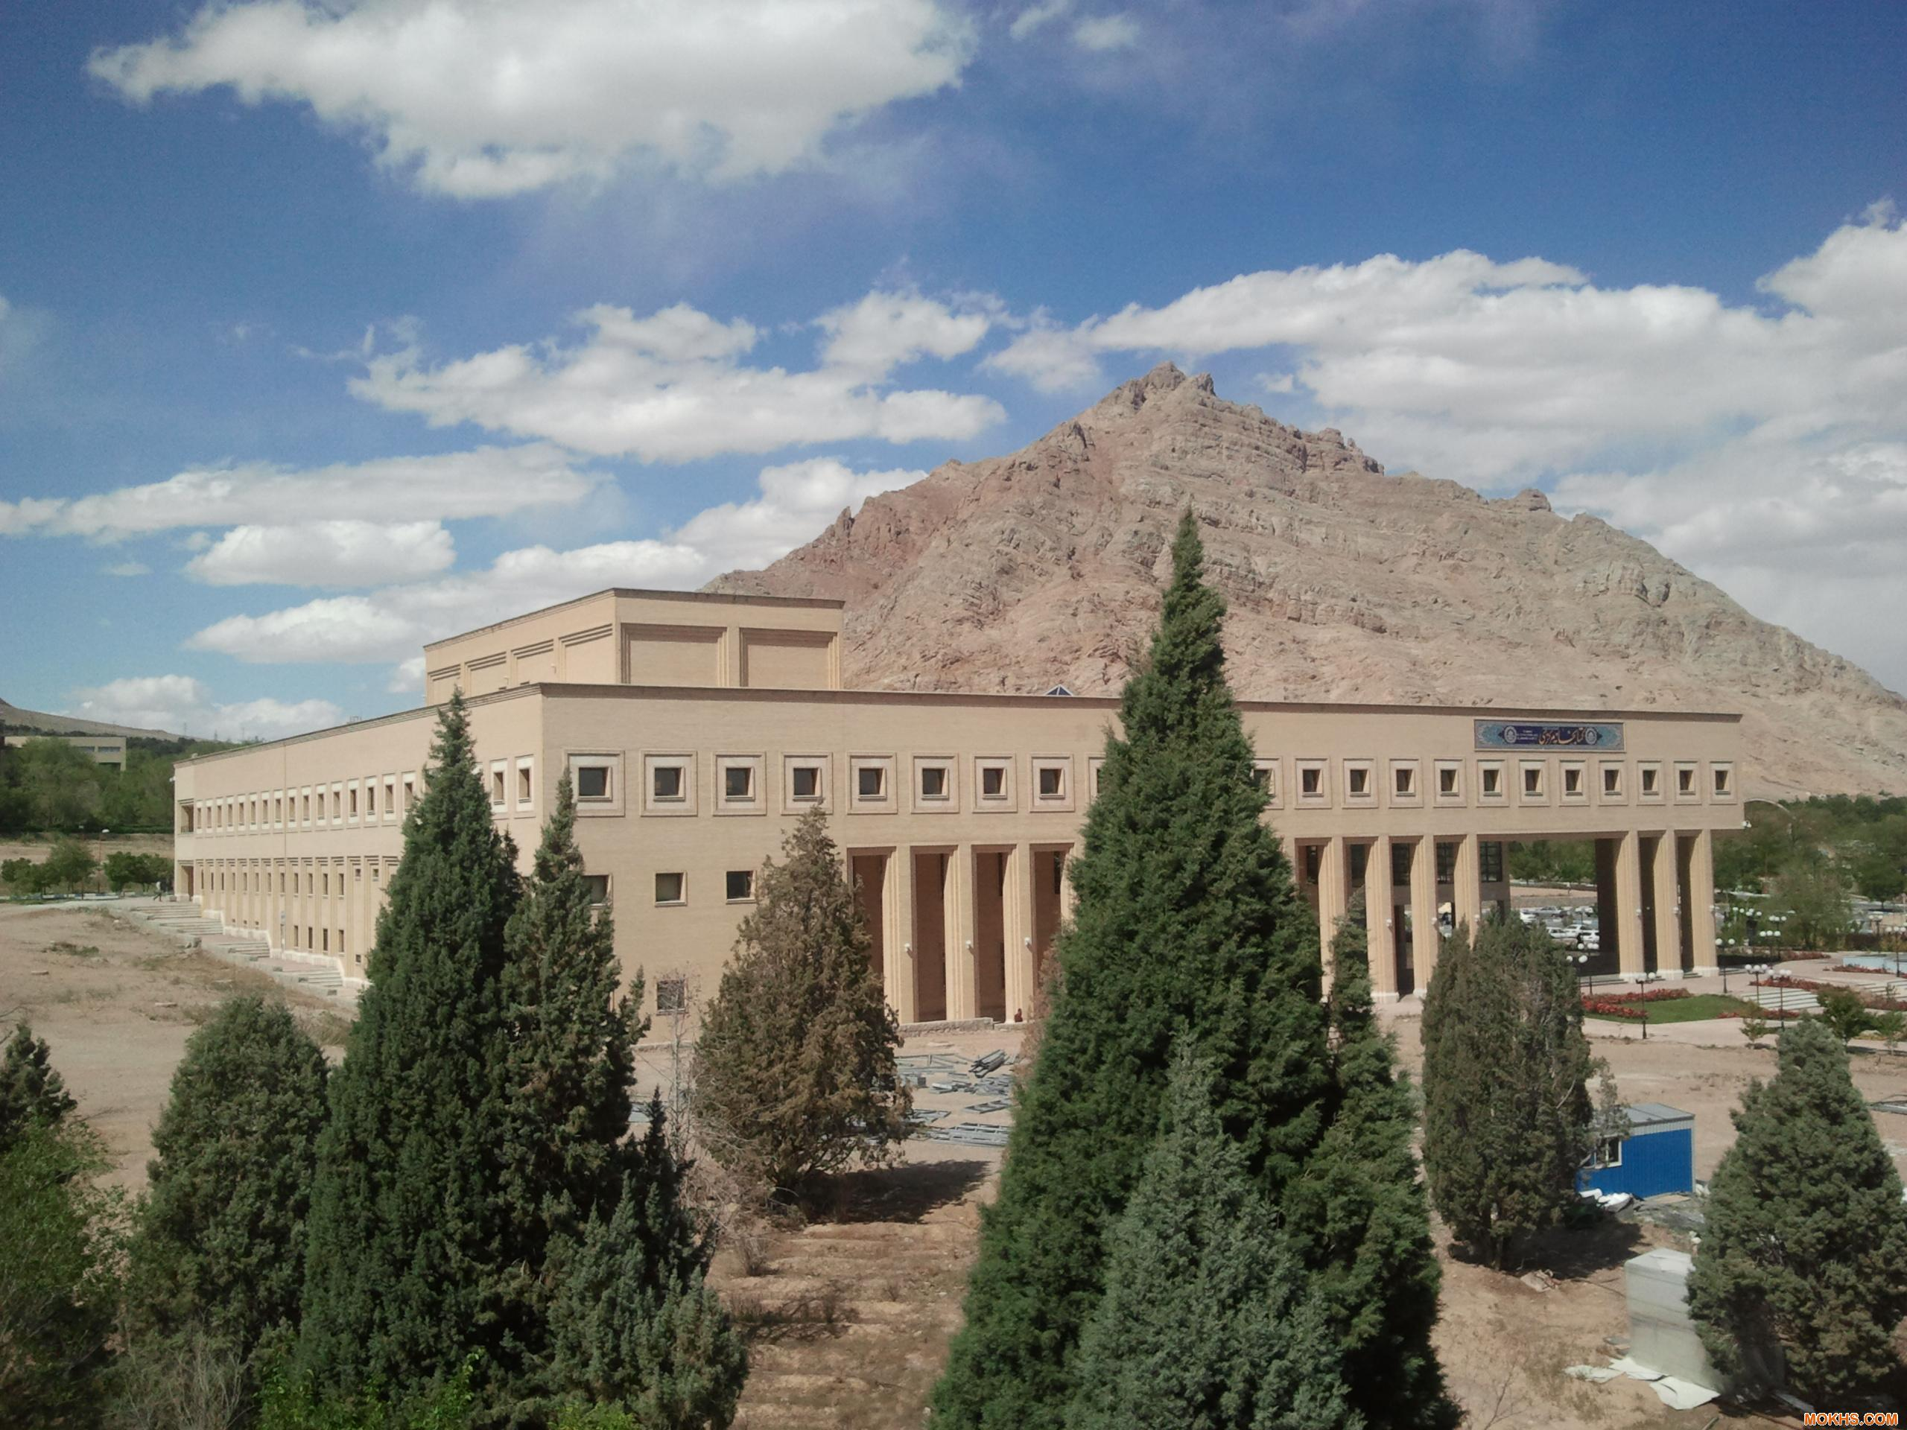

Big Data & Data Lake
Autumn 2018
Mohammad Amin Nikbakht

Slide 2

Types Of Computing
Agenda
Big Data
Data Lake
Discussions

Slide 3
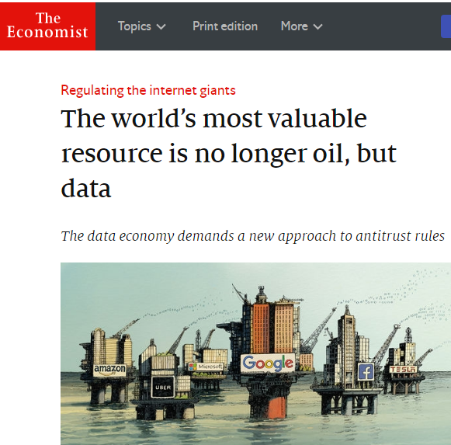
Types Of Computing
Most Valuable Resource
Distributed Computing
Centralized Computing

Slide 4

BIG
Shares traded on US Stock Markets each day:
Data generated in one flight from NY to London:
Distributed Computing
Centralized Computing
DATA
7 Billion
10 Terabytes
Number of tweets per day on Twitter:
Number of ‘Likes’ each day on Facebook:
Data that is TOO LARGE & TOO COMPLEX for conventional data tools to capture, store and analyze.
400 Million
3 Billion
The 4V’s of Big Data
Velocity
90
%
OF THE WORLD’S DATA WAS GENERATED IN THE
LAST TWO YEARS
Volume
Variety
Veracity

Slide 5
Types Of Computing
Data Scientist:
A Business analyst is not able to discover insights from huge sets of data of different domains.
Data scientists can work in co-ordination with different verticals of an organization and find useful patterns/insights for a company to make tangible business decisions.
The
SEXIEST
Distributed Computing
Centralized Computing
Job
21
In The
ST
century
15,000%
INCREASE IN JOB POSTINGS FOR DATA SCIENTISTS IN THE US BETWEEN 2011-12
Harvard Business Review, Oct 2012

Slide 6
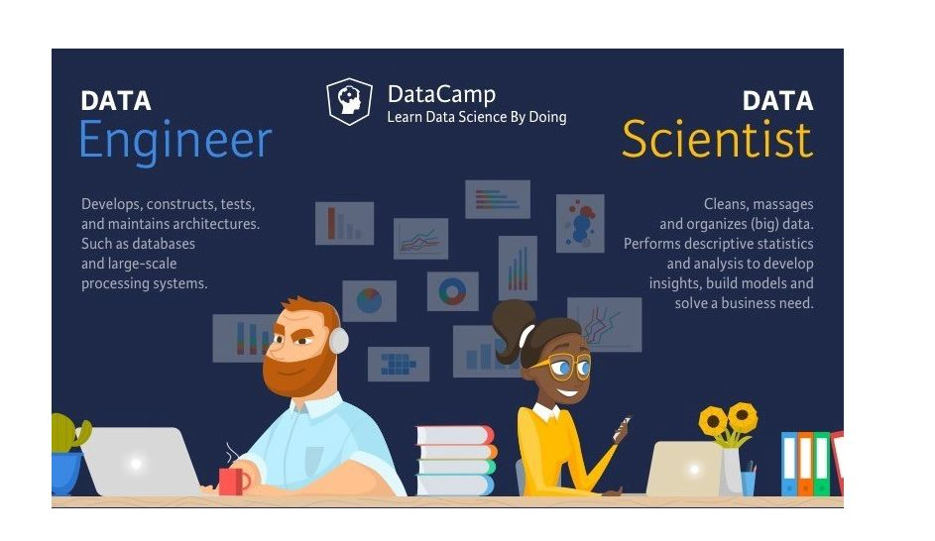
Distributed Computing
Centralized Computing

Slide 7
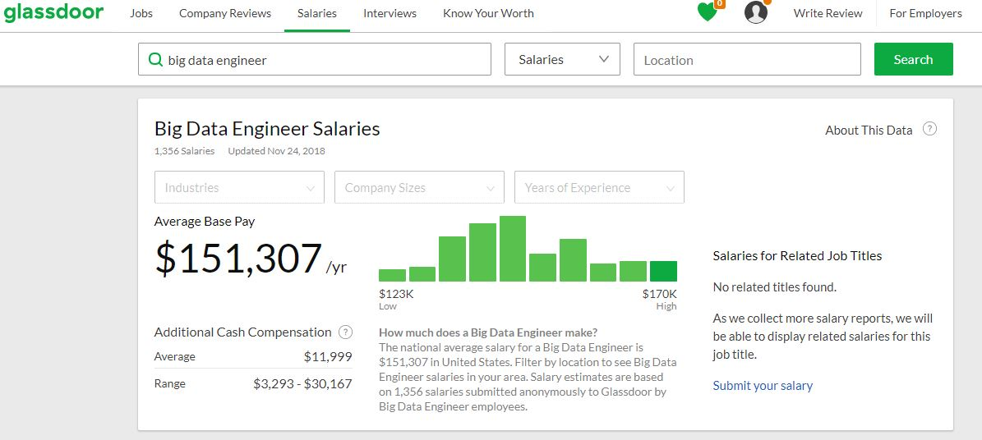
Distributed Computing
Centralized Computing

Slide 8
Types Of Computing
Distributed Computing
Centralized Computing
Data Lake

Slide 9
Types Of Computing
Session objectives and key takeaways
Objective:
Understand how the traditional data landscape is changing, what opportunities big data presents and what architectures allow you to maximize the benefits to your organization.
Key Takeaways:
Data lake architectures can be additive to your data warehouse
Data Lake makes building big data environments easy
Distributed Computing
Centralized Computing

Slide 10

Types Of Computing
The traditional data warehouse
BI and analytics
“… data warehousing has reached the most significant tipping point since its inception. The biggest, possibly most elaborate data management system in IT is changing.”
Distributed Computing
Centralized Computing
Dashboards
Reporting
Data warehouse
ETL
Data sources
OLTP
ERP
CRM
LOB

Slide 11
Types Of Computing
Big Data is driving transformative changes
Distributed Computing
Centralized Computing
Data
Characteristics
Cost
Culture

Slide 12
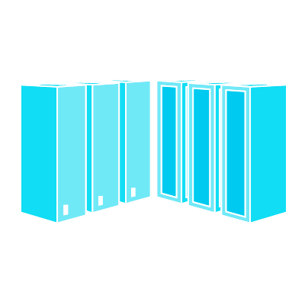
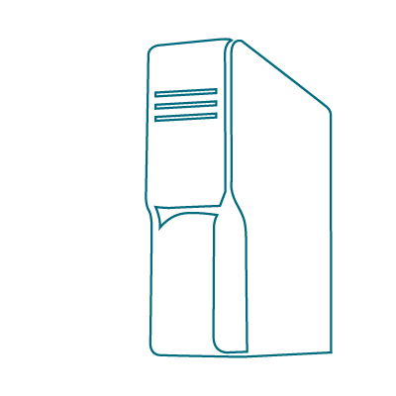
Types Of Computing
Big Data is driving transformative changes
Traditional
Big Data
Distributed Computing
Centralized Computing
Data
Characteristics
Relational
(with highly modeled schema)
All Data
(with schema agility)
Expensive
(storage and compute capacity)
Commodity
(storage and compute capacity)
Cost
Rear-view reporting
(using relational algebra)
Intelligent action
(using relational algebra AND ML, graph, streaming, image processing)
Culture

Slide 13
Types Of Computing
Traditional business analytics process
Start with end-user requirements to identify desired reports and analysis
Define corresponding database schema and queries
Identify the required data sources
Create a Extract-Transform-Load (ETL) pipeline to extract required data (curation) and transform it to target schema (‘schema-on-write’)
Create reports, analyze data
New
requirements
Create ETL pipeline
Identify data sources
Create reports Do analytics
Identify data schema and queries
Distributed Computing
Centralized Computing
Relational
Dedicated ETL tools (e.g. SSIS)
ETL pipeline
Queries
LOB Applications
Defined schema
Results
All data not immediately required is discarded or archived
13

Slide 14
Types Of Computing
New big data thinking: All data has value
All data has potential value
Data hoarding
No defined schema—stored in native format
Schema is imposed and transformations are done at query time (schema-on-read).
Apps and users interpret the data as they see fit
Distributed Computing
Centralized Computing
Iterate
Gather data from all sources
Store indefinitely
Analyze
See results
14

Slide 15
The Data Lake
Devices
Social
Devices
Batch queries
Dashboards
Reports
Exploration
Web
Video
Cooked Data
Interactive queries
Web
Sensors
Real-time analytics
Clickstream
Sensors
Click-stream
Social
Machine Learning
Queries
Video
Meta-Data,
Joins
Cooked
Data
Relational
ETL pipeline
Results
LOB Applications
Defined schema

Slide 16

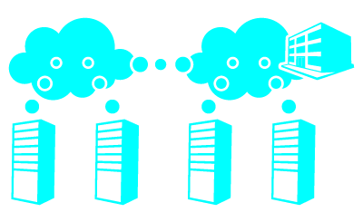
Types Of Computing
However, Big Data is not easy…
Distributed Computing
Centralized Computing
Obtaining skills
and capabilities
Determining how
to get value
Integrating with
existing IT investments

Slide 17




Types Of Computing
Event ingestion patterns
excel
Real Time Dashboards
Distributed Computing
Centralized Computing
Business apps
Stream Analytics
Event Hubs
Events
Transformed Data
Events
Custom apps
Kafka
Spark Streaming
Event Collection
Stream Processing
Sensors and devices
Raw Events
Data Lake Store

Slide 18
Distributed Computing
Centralized Computing
HDFS

Slide 19
Types Of Computing
Distributed Computing
Centralized Computing
Distributed Computing
Centralized Computing

Slide 20
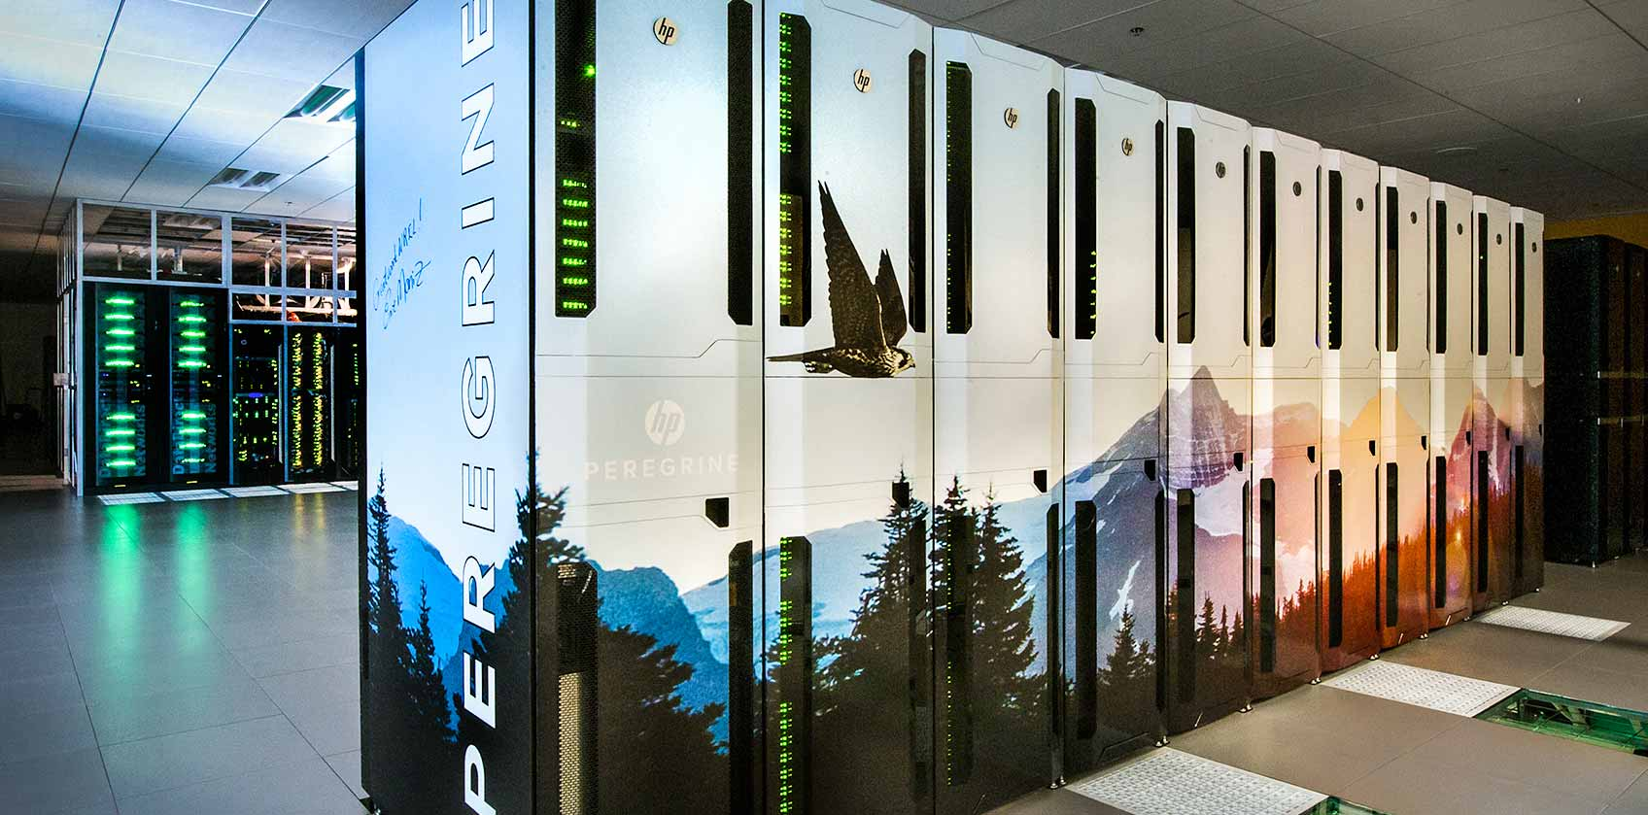
Distributed Computing
Centralized Computing
Centralized Computing

Slide 21
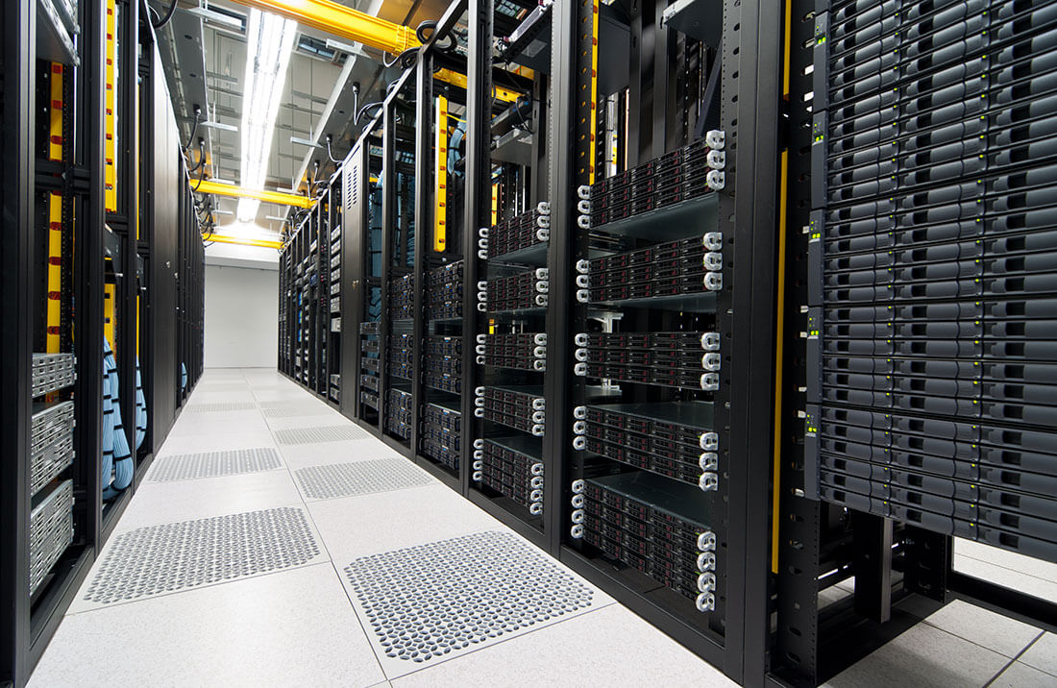
Distributed Computing
Centralized Computing
Distributed Computing

Slide 22
Distributed Computing
Distributed Computing
Centralized Computing
Pros
Flexibility
Vendor independence
Distance & location independence
Cons
More complex management & control
Security

Slide 23
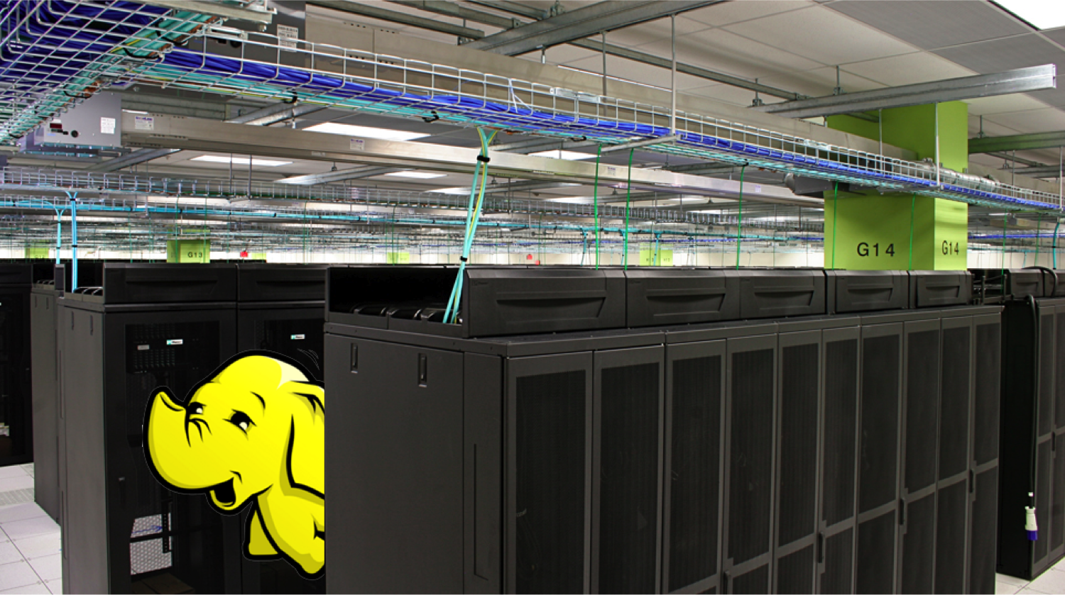
What is Hadoop ?
Distributed Computing
Centralized Computing

Slide 24
What is Hadoop ?
Benefits of Hadoop
Distributed Computing
Centralized Computing
Store and process big data of any kind quickly
Flexibility with data structure and preprocessing
Fault tolerance
Scalable
Low cost

Slide 25
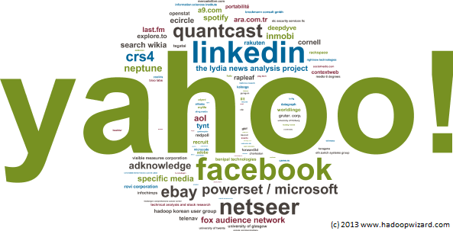
What is Hadoop ?
Who uses Hadoop?
Distributed Computing
Centralized Computing

Slide 26
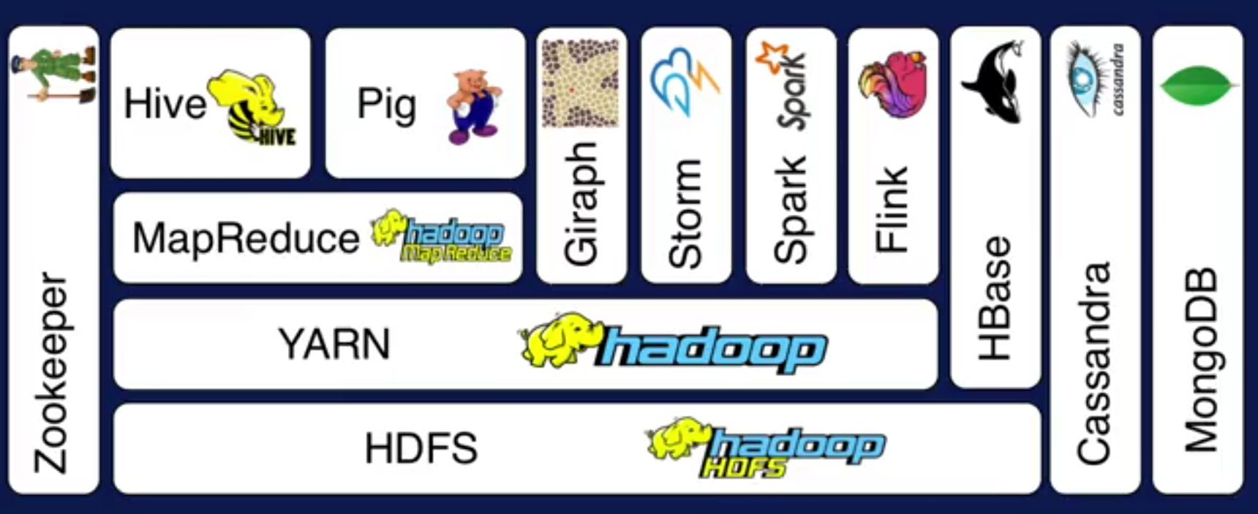
What is Hadoop ?
Hadoop Ecosystem
A
Layer Diagram
Distributed Computing
Centralized Computing
B
C
D

Slide 27
What is Hadoop ?
Hadoop HDFS
Hadoop distributed File System (based on Google File System (GFS) paper, 2004)
Serves as the distributed file system for most tools in the Hadoop ecosystem
Scalability for large data sets
Reliability to cope with hardware failures
HDFS good for:
Large files
Streaming data
Not good for:
Lots of small files
Random access to files
Low latency access
Distributed Computing
Centralized Computing

Slide 28
What is Hadoop ?
Design of Hadoop Distributed File System (HDFS)
Distributed Computing
Centralized Computing
Master-Slave design
Master Node
Single NameNode for managing metadata
Slave Nodes
Multiple DataNodes for storing data
Other
Secondary NameNode as a backup

Slide 29
What is Hadoop ?
HDFS
Distributed Computing
Centralized Computing
HDFS files are divided into blocks
It’s the basic unit of read/write
Default size is 64MB, could be larger (128MB)
Hence makes HDFS good for storing larger files
HDFS blocks are replicated multiple times
One block stored at multiple location, also at different racks (usually 3 times)
This makes HDFS storage fault tolerant and faster to read

Slide 30
What is Hadoop ?
HDFS Architecture
Distributed Computing
Centralized Computing
NameNode keeps the metadata, the name, location and directory
DataNode provide storage for blocks of data
Client
NameNode
Secondary NameNode
DataNode
DataNode
DataNode
DataNode
DataNode
DataNode
DataNode
DataNode
Heartbeat, CMD, Data

Slide 31
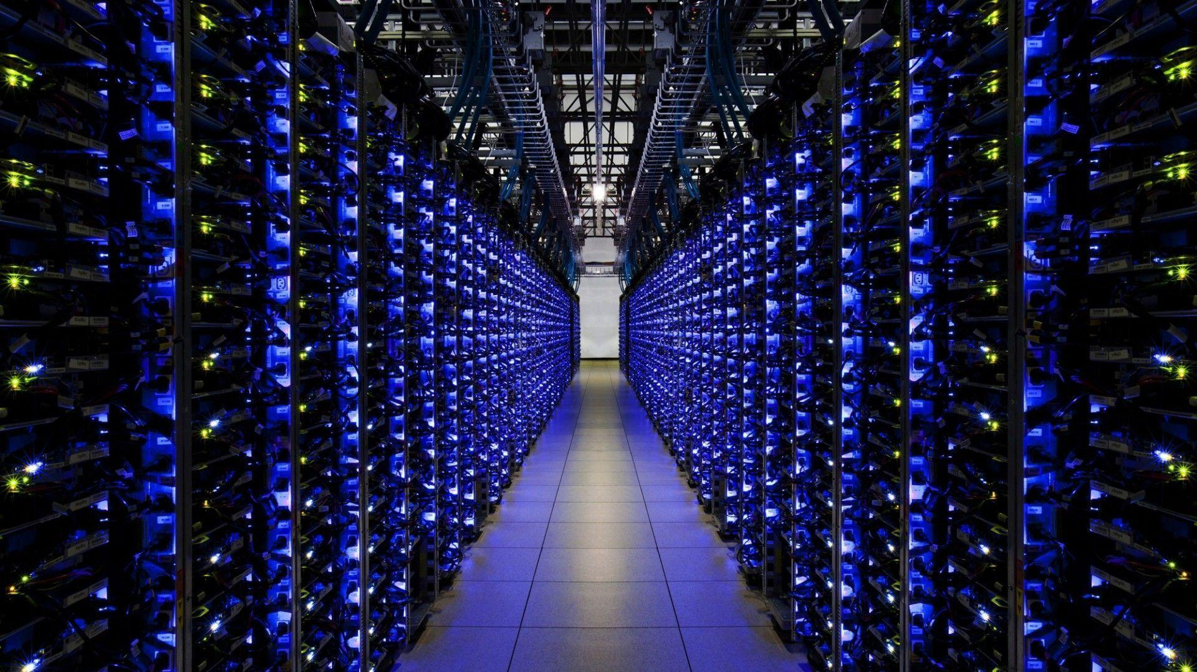
What is Hadoop ?
Distributed Computing
Centralized Computing
What happens if node(s) fail?

Slide 32
What is Hadoop ?
Solution
File
B1
B2
B3
B4
Distributed Computing
Centralized Computing
Node
Node
Node
Node
B1
B2
B4
B3
Node
Node
Node
Node
B1
B3
B1
B2
B4
Node
Node
Node
Node
B4
B3
B1
B2

Slide 33
What is Hadoop ?
MapReduce: Simple Programming for Big Data
Distributed Computing
Centralized Computing
MapReduce is simple programming paradigm for the Hadoop ecosystem
Traditional parallel programming requires expertise of different computing/systems concepts
examples: multithreads, synchronization mechanisms (locks, semaphores, and monitors )
incorrect use: can crash your program, get incorrect results, or severely impact performance
Usually not fault tolerant to hardware failure
The MapReduce programming model greatly simplifies running code in parallel
you don't have to deal with any of above issues
only need to create, map and reduce functions

Slide 34
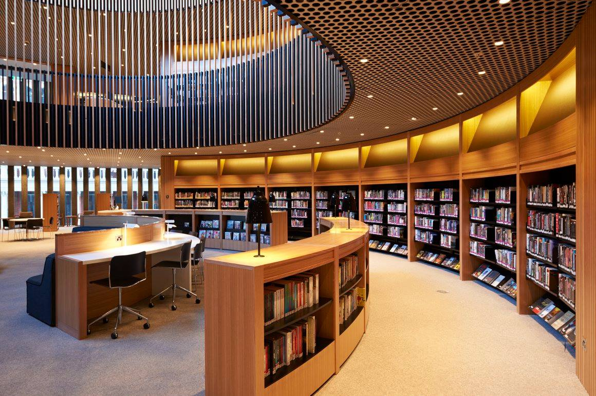
What is Hadoop ?
Distributed Computing
Centralized Computing

Slide 35
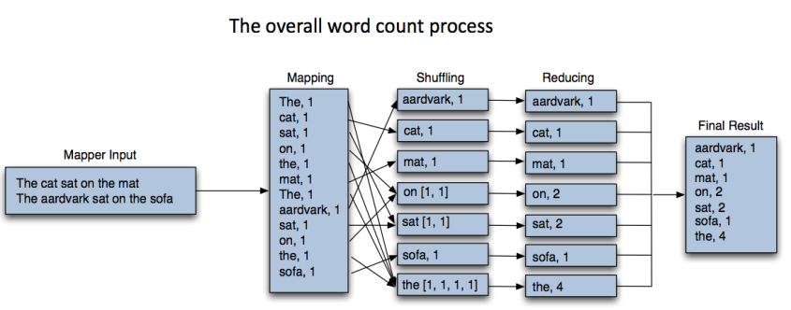
What is Hadoop ?
Word count
Distributed Computing
Centralized Computing
0:The cat sat on the mat
1:The aardvark sat on the sofa
Key: word
Value: count
Key: word
Value: sum of count

Slide 36
Types Of Computing
Thank you
Distributed Computing
Centralized Computing
Questions & Discussions

